Slide 1
August 25, 2010
Datacap for ECM Technical Professionals

Slide 2
Agenda
Product Briefing
About Datacap
Rules
Demonstration
Competitive info
Resources

Slide 3
Product Briefing Scott Blau, Director – ECM Capture Products
25 Aug 2010

Slide 4
About Datacap
Over 20 years as ISV
Headquartered in Tarrytown, NY
Led by co-founders (CEO & CTO)
Dedicated to document capture
First-mover technical innovation
Focused on demanding capture.
Notes:
4

Slide 5
Why IBM Acquired Datacap
True client/server architecture scales very large
Client-based licensing, not per-click
Rulerunner Service – core differentiator
Open and extensible
Leading recognition engines
Integrated thick and thin client interfaces
Lowest cost of ownership – licensing model
Maintains investment in FileNet Capture
Best of breed and single vendor

Slide 6
Awards
Smithsonian Award for Innovations that Benefit Society
Massachusetts Department of Revenue
Kinetic Information Process Innovation Awards
American College of Physicians
Hallmark Inc.
AIIM Best Of Show
Taskmaster 7 - Forms Processing Category
Notes:
6
Datacap has been recognized for its technical innovation.

Slide 7
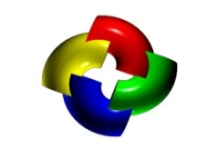
Main Products
Taskmaster
Rulerunner Service

Slide 8
Sample Applications in Taskmaster
1040EZ
Tax Forms
Flex
Database-driven indexing
Survey
Opinion/survey research
Express
Web-based indexing

Slide 9
Foundation Applications in Taskmaster
APT
Invoices… and
“Highly variable documents”
MClaims – Taskmaster for Medical Claims
US Health insurance Claims

Slide 10
Important Taskmaster Options
Wordfire
Content analytics for doc classification
Quattro
Rulerunner virtualization
Run up to 4 batches simultaneously on 1 machine

Slide 11
Value Progression
Multi-Core / Multi-CPU Support
SOA / Web Services Architecture
Advanced Document Identification
Distributed/Web-based Scanning
Complex OCR – Line Item Detail
Value / ROI
Reusable Business Rules
ICR Handprint Recognition
Simple OCR – Header Level
Optical Mark Recognition (OMR)
Barcode Recognition
Key From Image
Scan/Clean Up
Capabilities and Sophistication
Notes:
11
The highest level of ROI opportunity further leverages the automated data extraction to actually feed data to business systems.
This is the level we will continue to discuss throughout the remainder of this presentation.

Slide 12
Document Capture Process…
Scan
Recog
Verify
Export

Slide 13
Document Capture – 2010
Why is document capture so hard?
Varying requirements
Varying documents
“Unreliability” of recognition
Exceptions, exceptions, exceptions…

Slide 14
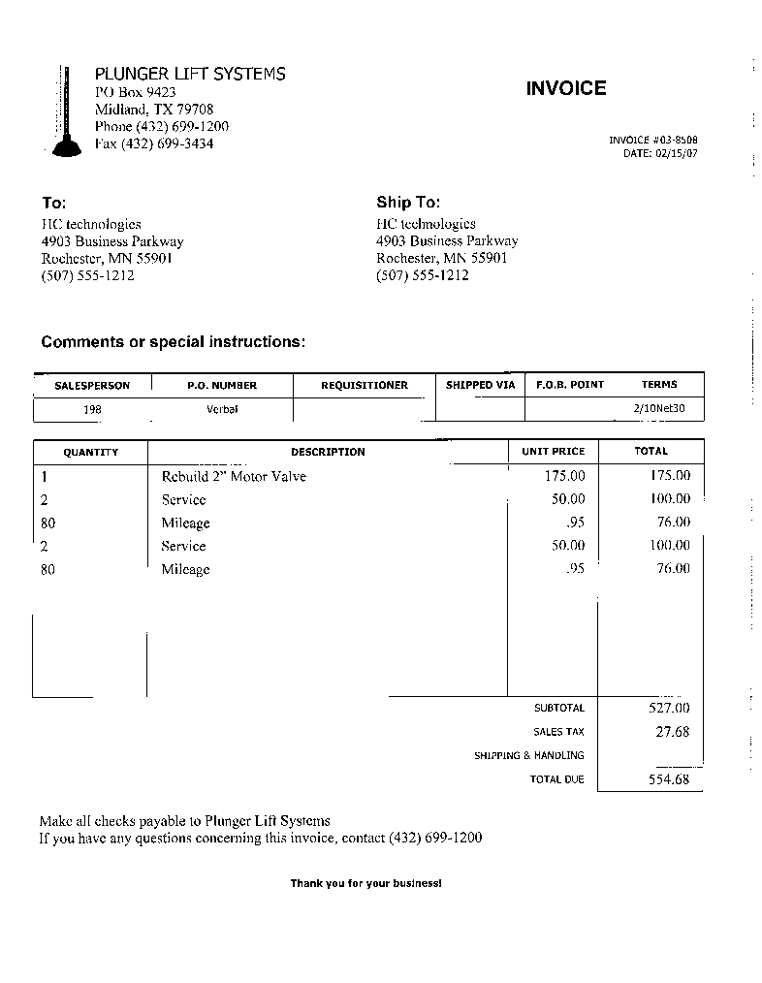
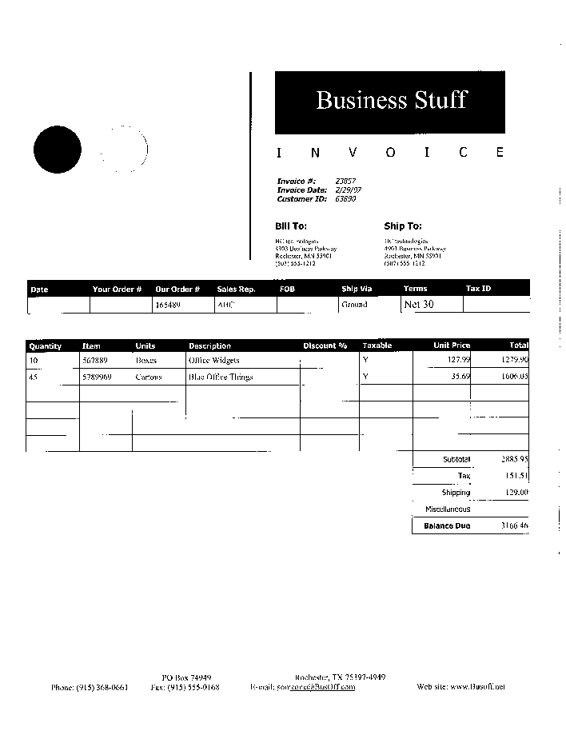
Variability is the challenge…

Slide 15
The Datacap Difference – Rules
How rules enable effective doc capture…
Rules logic excels in handling variability
Rules empower customers for exception handling
Rules are not just check box options – they are reusable code snippets…
Rules are extensible – easy to create in .NET, VB Script, etc.

Slide 16
Taskmaster Architecture Overview
Notes:
Build shows:
Taskmaster Server, the hub of the capture system
Taskmaster database, accessed exclusively by Taskmaster Server
Thick client stations for scanning and verification/indexing
Rulerunners, clients to Taskmaster Server, but more like servers themselves
Taskmaster Web, true 3 tier architecture for thin client scanning and indexing
Access to network resources for Taskmaster Web clients.
Rulerunner Service, either “local” or as a true web service

Slide 17
Rules Innovation
1994 – Integrated Capture Workflow
2006 – Capture Web Services
2008 – Flex Agile Implementation
1989 - PC-based Forms Processing
2000 – Web-based Capture
2009-10
Rulerunner Quattro
FastDoc Capture
eDoc Actions
1988
1992 – 1st PC ICR Solution
2002 – Invoice Processing
1998 – Healthcare Claims Processing
2007 – Document ID with Text Analytics
Notes:
17

Slide 18
The New Capture Paradigm
Scan
Recog
Verify
Export

Slide 19
Wraps core capture capabilities
Business rules/validations
Page/Doc identification
OCR, ICR, OMR, Bar codes
Dynamic location of data
Release of docs and data.

Slide 20
Building on Rulerunner Service
Taskmaster
Non-Datacap
Rulerunner Service

Slide 21
Rulerunner Service
Actions – the building block, written in .NET, VB Script, etc., that return true or false.
Functions - A series of actions that execute as long as they return true.
Rules – A group of functions executed until one completes with all actions true.
Rules are bound to a field, page, document, or batch
Reusable, flexible, rapid implementation, easy to modify

Slide 22
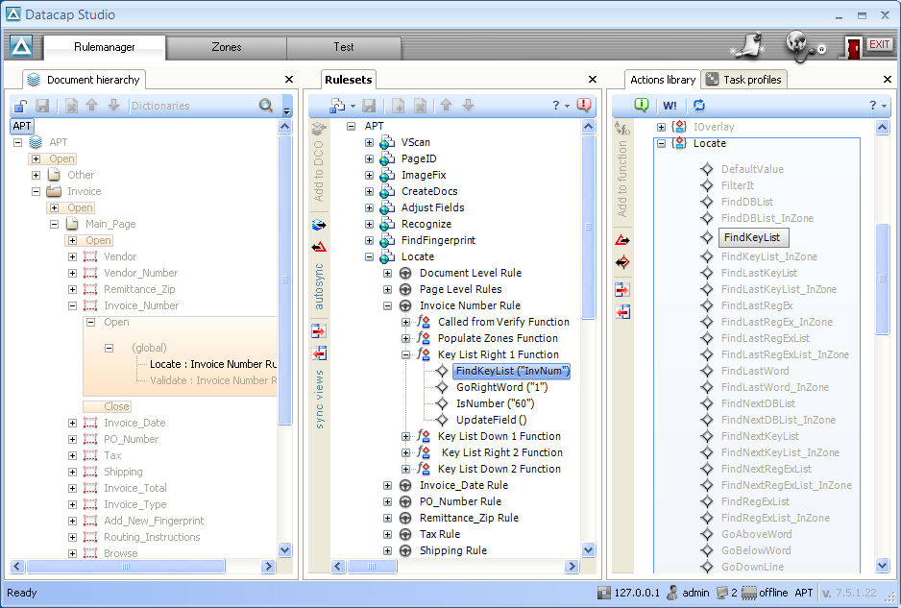
Action library
Rule bound to field
Action in a rule…

Slide 23
What is a Rule?
A set of steps, called Actions
Run on any object
Batch, Document, Page, Field
Scripted or Compiled
Store and reuse from Rules Library
Notes:
23

Slide 24
Rules in Action
IsNumeric(100)
An Action
A TRUE or FALSE function that processes on a field, page, document, or batch.
Notes:
24

Slide 25
Rules in Action
Func1: 5 digit Zipcode
IsNumeric(100)
A Function
MinimumLength(5)
MaximumLength(5)
An ordered list of actions that runs on an object until an action returns FALSE.
Notes:
25

Slide 26
Rules in Action
Func1: 5 digit Zipcode
IsNumeric(100)
TRUE
Data:
MinimumLength(5)
TRUE
65265
MaximumLength(5)
TRUE
Data PASSES Validation
Notes:
26

Slide 27
Rules in Action
Func1: 5 digit Zipcode
IsNumeric(100)
TRUE
Data:
MinimumLength(5)
TRUE
652657
MaximumLength(5)
FALSE
Data FAILS Validation
Notes:
27

Slide 28
Rules in Action
Func1: 5 digit Zipcode
IsNumeric(100)
FALSE
Data:
MinimumLength(5)
asdf
MaximumLength(5)
Data Fails Validation
Notes:
28

Slide 29
Rules in Action
Func1: 5 digit Zipcode
IsNumeric(100)
A Rule
MinimumLength(5)
MaximumLength(5)
An ordered collection of functions that process an object until one function is completely TRUE, or all functions are exhausted.
Func2: 9 digit Zipcode
IsNumeric(90)
MinimumLength(10)
MaximumLength(10)
Notes:
29

Slide 30
Rules in Action
Func1: 5 digit Zipcode
IsNumeric(100)
TRUE
Data:
MinimumLength(5)
TRUE
65265
MaximumLength(5)
TRUE
Data PASSES Validation
Func2: 9 digit Zipcode
IsNumeric(90)
MinimumLength(10)
MaximumLength(10)
Notes:
30

Slide 31
Rules in Action
Func1: 5 digit Zipcode
IsNumeric(100)
FALSE
Data:
MinimumLength(5)
65265-0073
MaximumLength(5)
Data PASSES Validation
Func2: 9 digit Zipcode
IsNumeric(90)
TRUE
MinimumLength(10)
TRUE
MaximumLength(10)
TRUE
Notes:
31

Slide 32
Rules in Action
Func1: 5 digit Zipcode
IsNumeric(100)
FALSE
Data:
MinimumLength(5)
asdf
MaximumLength(5)
Data FAILS Validation
Func2: 9 digit Zipcode
IsNumeric(90)
FALSE
MinimumLength(10)
MaximumLength(10)
Notes:
32

Slide 33
Rules in Action
Func1: 5 digit Zipcode
IsNumeric(100)
TRUE
Data:
MinimumLength(5)
TRUE
65265073
MaximumLength(5)
FALSE
Data FAILS Validation
Func2: 9 digit Zipcode
IsNumeric(90)
TRUE
MinimumLength(10)
FALSE
MaximumLength(10)
Notes:
33

Slide 34
Rules are:
Flexible, extensible,
Reusable,
Standard,
Not limited to validations…
Notes:
34
Datacap Reusable Rules provide complete control over the capture process
Batch, Document, Page, Field
Scan, recognition, verify and export
Store and reuse from Rules Library
Fast implementation
Easily adapts to change
Lower Professional Services cost

Slide 35
Summary
True client/server architecture scales very large
Client-based licensing, not per-click
Rulerunner Service – core differentiator
Open and extensible
Leading recognition engines
Integrated thick and thin client interfaces
Lowest cost of ownership

Slide 36
Competitive Information and Resources Maig Worel, WW ECM Demo Team
25 Aug 2010

Slide 37
Competition
Key Competitors
Kofax
EMC / Captiva
Oracle / Captovation / Brainware (OEM, forms processing)
Open Text / Captaris
Readsoft (Sweden) Accounts Payable automation, workflow
Key Differentiators for Technical folks
Single Vendor Integration
Control with Flexibility – the Rules
Distributed capture – thin web based client
Technical Features to Highlight
Ease of demonstration/usability
Fine grained control – see image fix controls for example
VERY flexible and extendable
Web based, thick client, and offline (FastDoc capture)
Enterprise services, with RM, workflow, process available in integrated stack
Easy to install

Slide 38
Competition: Kofax
Key Differentiators:
Kofax is the market leader in capture
Kofax is the largest pure play capture vendor
Kofax products are easy to demonstrate and show
Key Competitive Gaps:
Capture market has consolidated with ECM, leaving Kofax without ECM and imaging platforms to sell
Kofax is no longer recognized as the technology leader in the capture segments it serves
Competitive Positioning:
Kofax’s lack of ECM stack and waning technology leadership make it an increasingly tough sell to ECM customers, while IBM’s addition of Datacap provide both completeness and technology leadership from a single, market-leading vendor.
Example: Handwriting, barcode, machine print, checkboxes
Kofax would require hardcore coding to handle this document for KTM
Indicius could handle it without extra coding – but could only do it as a fixed form.
Datacap can use the rules engine, and just apply the rule over the field. More flexibility.
Faster ROI – less cost for professional services, quicker application delivery

Slide 39
Competition: EMC / Captiva
Key Differentiators:
Complete suite of capture offerings for ECM integrated with both EMC and IBM ECM
EMC/Captiva strategy is steep discounts on software to sell storage hardware
Uses capture as a wedge to displace ECM competitors
Key Competitive Gaps:
Relies on aggressive discounting, rather than product strength, to win
Traditional capture technology cannot be deployed as enterprise services
Competitive Positioning:
EMC/Captiva is IBM’s true competitor for imaging and capture, but Datacap’s advanced technology (ability to run capture as services) gives IBM a distinct advantage in enterprise capture opportunities
Example: Handwriting, barcode, machine print, checkboxes
Requires C++ or other programming – expensive programmer
VBScript or .Net rules can be mixed and matched to build an application. A business analyst can do that

Slide 40
Competition: Oracle / Captovation / Brainware (OEM, forms processing)
Key Differentiators:
Dedicated capture offering for its ECM products acquired via Stellent
FUSION vision for integrating ECM and capture into the larger suite of applications and RDBMS technologies
Key Competitive Gaps:
Inability to deliver on FUSION message
Reliance on OEM (Brainware) for advanced capture capabilities
Late to imaging and capture market with unclear message
Competitive Positioning:
Oracle is not considered (by analysts or prospects) a market leader in Capture or Imaging, whereas IBM leads in functionality and market share.
Example: Handwriting, barcode, machine print, checkboxes
Brainware is OEM’d as their front end, so they replaced it with Datacap. The Datacap UI is so much more flexible, and Brainware is difficult to work with. Customized processing of documents – say you want to expand beyond AP to add other departments. Focus on extensibility. Brainware plays mostly in the AP space.

Slide 41
Competition: Open Text / Captaris
Key Differentiators:
Market leading tools, including OCR and Fax
Offers capture for its complete ECM stack
Key Competitive Gaps:
Seen as provider of tools, rather than complete capture suite
Unclear strategy on capture and imaging
Competitive Positioning:
Although it offers capture and forms processing applications, Open Text is perceived as a tool provider with inconsistent capture focus, whereas IBM is a leader in the imaging and capture market.
Example:
Datacap was a front end for Captaris when Opentext bought them. Their offering is pretty rudimentary. Even FastDoc capture, a simpler product, is more impressive.

Slide 42
Competition: Readsoft, ABBYY, Knowledge Lake
Readsoft (Sweden) has an Accounts Payable with some automation and workflow
Hit them with: Solutions outside of Accounts payable
ABBYY provides the engine to Datacap for Russian and other language recognition.
FlexiCapture uses the ABBYY engine with a rudimentary solution. Automated indexing is OK but line item extraction and advanced capture aren’t there.
Everybody (just about) uses this engine for recognition
Hit them with: Line items, advanced capture options
Knowledge Lake
A bit basic, often uses Readsoft, has SharePoint limitations for workflows so not very flexible
Hit them with: Advanced workflows

Slide 43
Resources and Tools
Community http://w3.ibm.com/connections/communities/service/html/communityview?communityUuid=45274911-4b22-4b67-80a0-dec2c46dffc2
Technical Information Kit http://w3.ibm.com/connections/wikis/home?lang=en#/wiki/W6a3fc83ae160_463a_85c1_fcb936bd589e/page/Technical%20Information%20Kit
Datacap Seller Resources
http://w3-103.ibm.com/software/xl/portal/content?synKey=G279133P13996H05
VDC (hosted) - available next week
Tech Wiki
https://w3.tap.ibm.com/w3ki2/display/CMWIKI1/Datacap
Getting Software
Software is available on a very limited basis due to support limitations.
Demonstration software is available now, see the Demo Gallery
Getting Help
Sales assistance, RFIs, etc. – email askdatacap@us.ibm.com
North Americas –Open a TechXPress Request
Technical assistance: Ben Antin, Amit Saha, Maig Worel

Slide 44
Education
Hands on Labs (1 day) available early September
3 day Hands on Lab available late September
Localization documentation in progress
Webinars –
Monday Sales Series – see announcement in Wednesday’s email
Technical webinars TBD
More TBD

Slide 45
Q & A
Questions?

